Slide 1
WRES2203 Advanced Network Technology
Chapter 10
Securing Site-to-Site Connectivity

Slide 2
Contents
Introduction
Types of VPN
GRE
IPSec

Slide 3
Introduction
Organizations use VPNs to create an end-to-end private network connection over third-party networks such as the Internet or extranets.
A VPN is a private network created via tunneling over a public network, usually the Internet.
A VPN is a communications environment in which access is strictly controlled to permit peer connections within a defined community of interest.
To implement VPNs, a VPN gateway is necessary. The VPN gateway could be a router, a firewall, or a Cisco Adaptive Security Appliance (ASA) device.

Slide 4
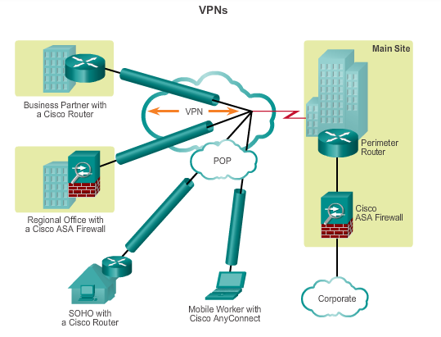
Introduction

Slide 5
Introduction
Benefit of VPNs
  Cost savings
    Enable organizations to use cost-effective, third-party Internet transport to connect remote offices and remote users to the main site
  Scalability
    Enable organizations to use the Internet infrastructure within ISPs and devices, which makes it easy to add new users.
  Compatibility with broadband technology
    Allow telecommuters to take advantage of high-speed, broadband connectivity, such as DSL and cable, to access to their organizations’ networks.

Slide 6
Introduction
  Security
    Can include security mechanisms that provide the highest level of security by using advanced encryption and authentication protocols that protect data from unauthorized access.

Slide 7
Types of VPN
Site-to-Site VPN
  Created when devices on both sides of the VPN connection are aware of the VPN configuration in advance.
  The VPN remains static, and internal hosts have no knowledge that a VPN exists.
  End hosts send and receive normal TCP/IP traffic through a VPN “gateway”. The VPN gateway is responsible for encapsulating and encrypting outbound traffic for all traffic from a particular site.

Slide 8
Types of VPN
  The VPN gateway then sends it through a VPN tunnel over the Internet to a peer VPN gateway at the target site. Upon receipt, the peer VPN gateway strips the headers, decrypts the content, and relays the packet toward the target host inside its private network.
  Site-to-site VPNs connect entire networks to each other, for example, they can connect a branch office network to a company headquarters network.

Slide 9
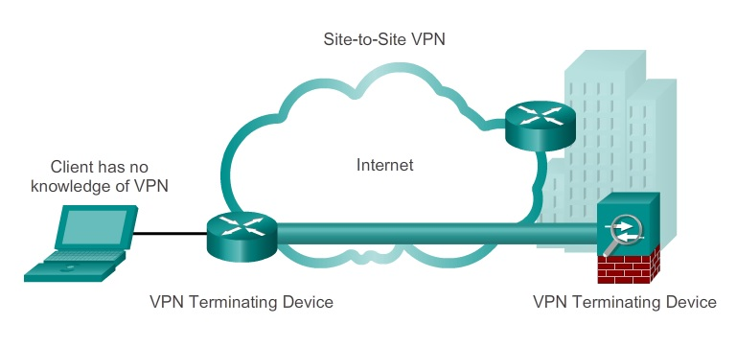
Types of VPN

Slide 10
Types of VPN
Remote-access VPNs
  Supports the needs of telecommuters, mobile users, and extranet, consumer-to-business traffic.
  Created when VPN information is not statically set up, but instead allows for dynamically changing information, and can be enabled and disabled.
  Support a client/server architecture, where the VPN client (remote host) gains secure access to the enterprise network via a VPN server device at the network edge.
  Used to connect individual hosts that must access their company network securely over the Internet.

Slide 11
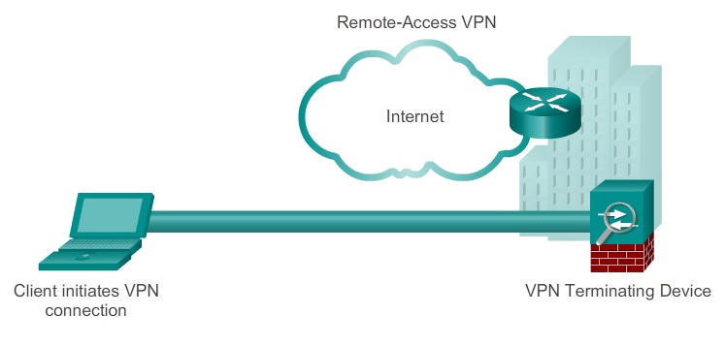
Types of VPN
  VPN client software may need to be installed on the mobile user’s end device. Example, Cisco AnyConnect Secure Mobility Client.

Slide 12
GRE
Generic Routing Encapsulation (GRE)
  Non-secure site-to-site VPN tunneling protocol.
  Encapsulate a wide variety of protocol packet types inside IP tunnels.
  Defined as an IETF standard (RFC 2784)
  47 is used in the protocol field
  GRE is stateless, does not include any flow-control mechanisms.
  GRE does not include any strong security mechanisms to protect its payload.
  At least 24 bytes of additional overhead for tunneled packets.

Slide 13
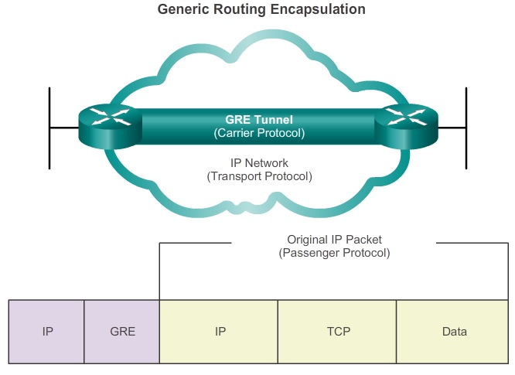
GRE

Slide 14
GRE
Configuration
  Step 1. Create a tunnel interface using the interface tunnel number command.
  Step 2. Specify the tunnel source IP address.
  Step 3. Specify the tunnel destination IP address.
  Step 4. Configure an IP address for the tunnel interface.
  Step 5. (Optional) Specify GRE tunnel mode as the tunnel interface mode.

Slide 15
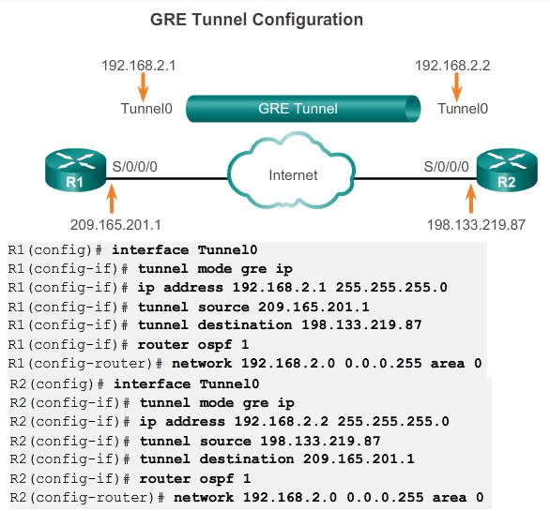
GRE

Slide 16
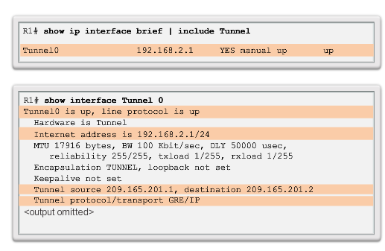
GRE

Slide 17
IPSec
IPsec VPNs offer flexible and scalable connectivity.
Provide a secure, fast, and reliable remote connection. To remain private, the traffic is encrypted to keep the data confidential.
IPsec is a framework of open standards that spells out the rules for secure communications. IPsec relies on existing algorithms to implement secure communications.
IPsec secures a path between a pair of gateways, a pair of hosts, or a gateway and host.
IPsec provides data confidentiality, data integrity, and origin authentication.

Slide 18
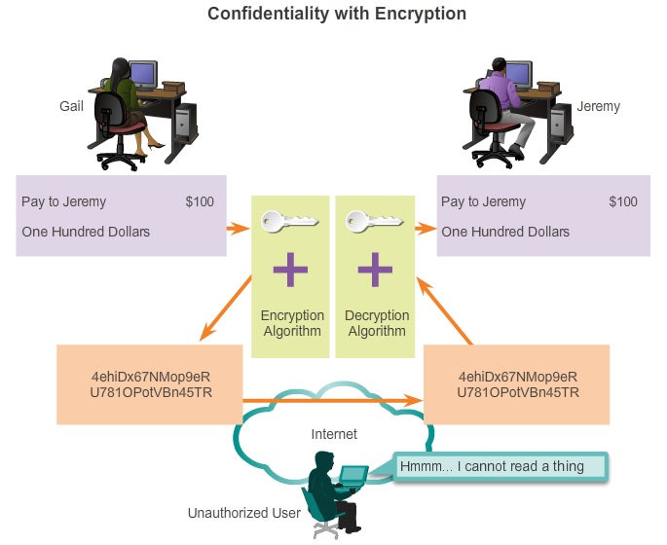
IPSec
Confidentiality
  Encrypting the data before transmitting it across the network.
  The degree of security depends on the key length of the encryption algorithm and the sophistication of the algorithm.

Slide 19
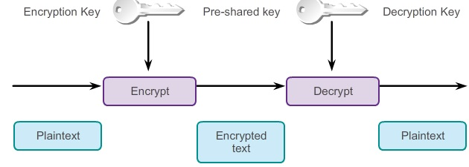
IPSec
Symmetric Encryption
  Secret-key encryption
  The same key can be configured on each device
  Each of the two networking devices must know the key to decode the information.
  Examples: DES, 3DES, and AES

Slide 20
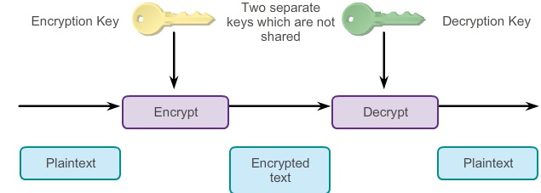
IPSec
Asymmetric Encryption
  Uses public key cryptography
  Uses different keys for encryption and decryption.
  The recipient gives a public key to any sender with whom the recipient wants to communicate.
  Typically used in digital certification and key management. Examples: Rivest-Shamir-Adleman (RSA)

Slide 21
IPSec
Data Integrity
  Ensure that the encrypted portion of the packet, or the entire header and data portion of the packet, has not been changed.
  IPsec ensures data integrity by using checksums.
  Diffie-Hellman (DH)
    It is a method to securely exchange the keys that encrypt data.
    Specifies a public key exchange method that provides a way for two peers to establish a shared secret key that only they know.

Slide 22
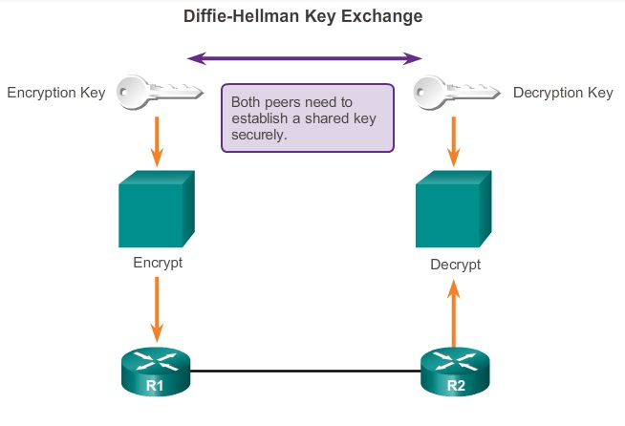
IPSec

Slide 23
IPSec
Hash algorithms provide data integrity and authentication by ensuring that unauthorized persons do not tamper with transmitted messages.
The sender generates a hash of the message and sends it with the message itself. The recipient parses the message and the hash, produces another hash from the received message, and compares the two hashes. If they are the same, the recipient can be reasonably sure of the integrity of the original message.
VPNs use a message authentication code to verify the integrity and the authenticity of a message, example Hash-based Message Authentication Code (HMAC).

Slide 24
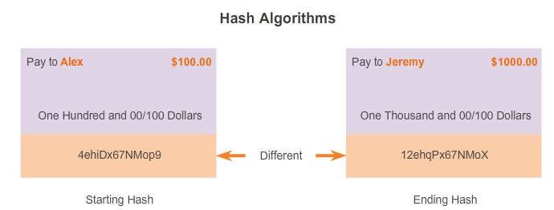
IPSec

Slide 25
IPSec
An HMAC has two parameters, a message input and a secret key that is known only to the message originator and intended receivers.
The message sender uses an HMAC function to produce a value (the message authentication code) that is formed by condensing the secret key and the message input.
The message authentication code is sent along with the message. The receiver computes the message authentication code on the received message using the same key and HMAC function as the sender used.
Then, the receiver compares the result that is computed with the received message authentication code.

Slide 26
IPSec
Two common HMAC algorithms:
  MD5
    Uses a 128-bit shared secret key. The output is a 128-bit hash. The hash is appended to the original message and forwarded to the remote end.
  SHA
    SHA-1 uses a 160-bit secret key. The output is a 160-bit hash. The hash is appended to the original message and forwarded to the remote end.

Slide 27
IPSec
Authentication
  Verify the identity of the source of the data that is sent.
  Ensures that the connection is made with the desired communication partner.
  Pre-Shared Key (PSK)
    A secret key that is shared between the two parties using a secure channel before it needs to be used.
    A PSK is entered into each peer manually and is used to authenticate the peer.

Slide 28
IPSec
  RSA signatures
    Digital certificates are exchanged to authenticate peers.
    The local device derives a hash and encrypts it with its private key.
    The encrypted hash, or digital signature, is attached to the message and forwarded to the remote end.
    At the remote end, the encrypted hash is decrypted using the public key of the local end. If the decrypted hash matches the recomputed hash, the signature is genuine.
    RSA signatures use a Certificate Authority (CA) to generate a unique-identity digital certificate that is assigned to each peer for authentication.

Slide 29
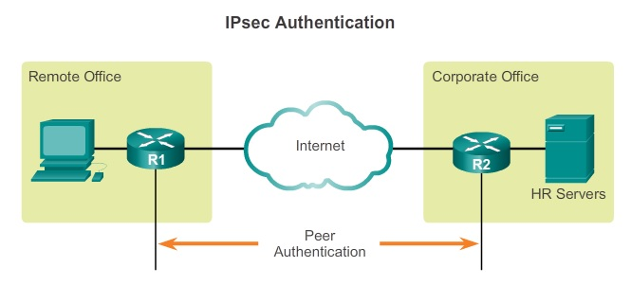
IPSec

Slide 30
IPSec
Anti-Replay Protection
  The ability to detect and reject replayed packets and helps prevent spoofing.
  Verify each packet is unique and not duplicated.

Slide 31
IPSec
IPsec Protocols
  Authentication Header (AH)
    Provides data authentication and integrity for IP packets that are passed between two systems.
    However, AH does not provide data confidentiality (encryption) of packets. All text is transported in plaintext.
  Encapsulating Security Payload (ESP)
    A security protocol that provides confidentiality and authentication by encrypting the IP packet.
    Authenticates the inner IP packet and ESP header.

Slide 32
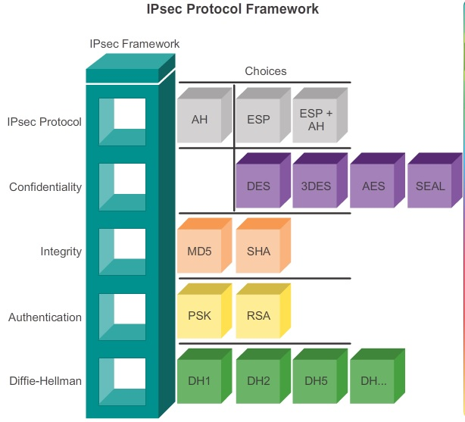
IPSec

Slide 33
IPSec
Two primary methods for deploying remote-access VPNs:
  Secure Sockets Layer (SSL)
    Offers “anywhere” connectivity
    Supports various cryptographic algorithms for operations, such as authenticating the server and client to each other, transmitting certificates, and establishing session keys.
    Web-based
    Cisco AnyConnect Secure Mobility Client with SSL
    Cisco Secure Mobility Clientless SSL VPN - Requires an Internet browser.

Slide 34
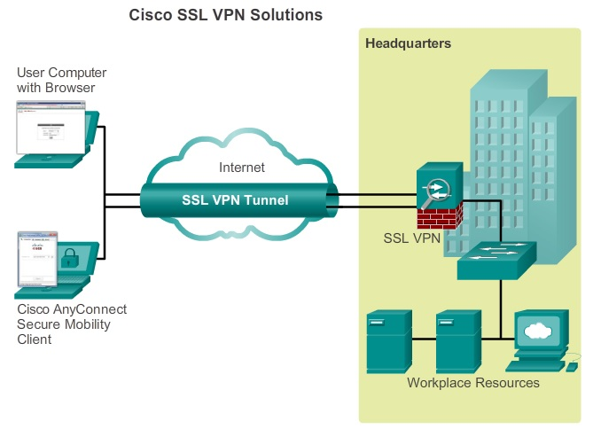
IPSec

Slide 35
IPSec
  IPSec
    Cisco Easy VPN Server
      A Cisco IOS router or Cisco ASA Firewall acting as the VPN head-end device in site-to-site or remote-access VPNs.
    Cisco Easy VPN Remote
      A Cisco IOS router or Cisco ASA Firewall acting as a remote VPN client.
    Cisco VPN Client
      An application supported on a PC used to access a Cisco VPN server.

Slide 36
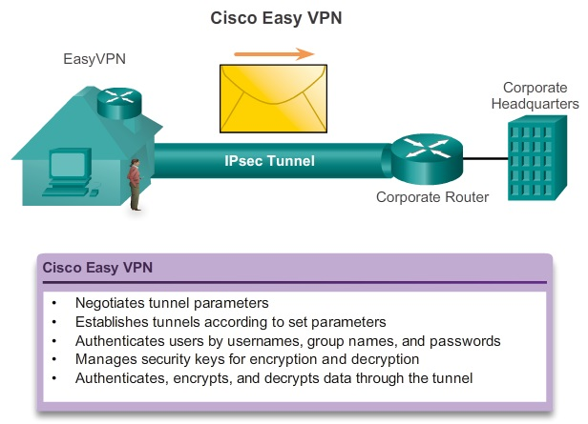
IPSec

